Slide 1



Learning Quantum Computing
Faculty of Sciences and Technology of
New University of Lisbon (FCT NOVA | FCT/UNL)
NOVA-LINCS (Laboratory for Computer Science and Informatics)
Lecture/Lesson 0:
Hello Quantum World
Rúben André Barreiro
(MSc. Computer Engineering - DI @ FCT NOVA)
Week 0 - July, 2019 | Lecture/Lesson 0
https://www.di.fct.unl.pt/ | http://nova-lincs.di.fct.unl.pt/
https://github.com/rubenandrebarreiro/learning-quantum-computing/

Slide 2

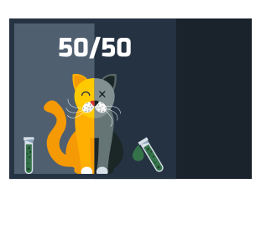


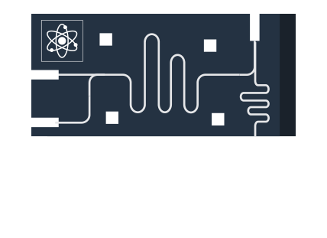




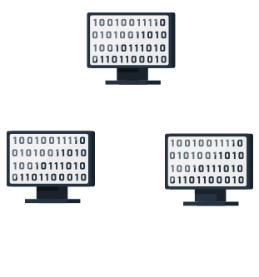
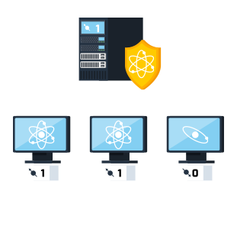




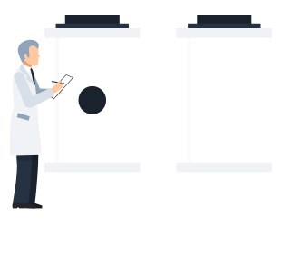



Hello Quantum World
Introduction
Rúben André Barreiro
(MSc. Computer Engineering - DI @ FCT NOVA)
Week 0 - July, 2019 | Lecture/Lesson 0
https://www.di.fct.unl.pt/ | http://nova-lincs.di.fct.unl.pt/
https://github.com/rubenandrebarreiro/learning-quantum-computing/

Slide 3
Hello Quantum World
Table of contents
Brief description of this course
Course overview
1
2
Rúben André Barreiro
(MSc. Computer Engineering - DI @ FCT NOVA)
Week 0 - July, 2019 | Lecture/Lesson 0
https://www.di.fct.unl.pt/ | http://nova-lincs.di.fct.unl.pt/
https://github.com/rubenandrebarreiro/learning-quantum-computing/

Slide 4
Hello Quantum World
Brief description of this course
This course is suited for beginners in Quantum Mechanics, Quantum Physics and Quantum Computing.
If you are familiar with the basic concepts of Quantum Mechanics and Quantum Physics, you are encouraged to move forward in this course, to the Lesson/Lecture TODO.
This course will be focused on learning by doing. So, don’t be nervous. A little sense of humor throughout this course will help you relax.
Rúben André Barreiro
(MSc. Computer Engineering - DI @ FCT NOVA)
Week 0 - July, 2019 | Lecture/Lesson 0
https://www.di.fct.unl.pt/ | http://nova-lincs.di.fct.unl.pt/
https://github.com/rubenandrebarreiro/learning-quantum-computing/

Slide 5
Hello Quantum World
Brief description of this course
Initially, it will be addressed the basic fundamentals, and concepts, of Quantum Mechanics, and Quantum Physics, in the basis of the study, and research on Quantum Computing.
It will be given a detailed, and complete, explanation of the Quantum Computing, and its advantages, and specifications.
It will be shown some existing prototypes of Quantum Computers. It will be shown also, their specifications, and capabilities.
Rúben André Barreiro
(MSc. Computer Engineering - DI @ FCT NOVA)
Week 0 - July, 2019 | Lecture/Lesson 0
https://www.di.fct.unl.pt/ | http://nova-lincs.di.fct.unl.pt/
https://github.com/rubenandrebarreiro/learning-quantum-computing/

Slide 6
Hello Quantum World
Brief description of this course
It will be explained, the architecture and components of a Quantum Computer, like per examples, QPUs, among others, and, how they work.
It will be addressed how a Quantum Computer process the information, and data, making also, a reference to its processing unit, the Quantum Bit (or, Qubit), and its computation power, and capabilities.
It will be made a comparison between Quantum Computing and Classical Computing, as also, showing the differences between them.
Rúben André Barreiro
(MSc. Computer Engineering - DI @ FCT NOVA)
Week 0 - July, 2019 | Lecture/Lesson 0
https://www.di.fct.unl.pt/ | http://nova-lincs.di.fct.unl.pt/
https://github.com/rubenandrebarreiro/learning-quantum-computing/

Slide 7
Hello Quantum World
Brief description of this course
It will be also addressed the history, and timeline, of the Quantum Computing, as also, its current state of art, and research, in Portugal, and worldwide.
It will be explored the many paradigm breaks that Quantum Computing promises to meet, in Artificial Intelligence, Cryptography, and Communications, per example, and some of its applications, like NMRs, among many others.
Rúben André Barreiro
(MSc. Computer Engineering - DI @ FCT NOVA)
Week 0 - July, 2019 | Lecture/Lesson 0
https://www.di.fct.unl.pt/ | http://nova-lincs.di.fct.unl.pt/
https://github.com/rubenandrebarreiro/learning-quantum-computing/

Slide 8
Hello Quantum World
Brief description of this course
It will be explained some of the existing Quantum Algorithms, proposed by many authors, like per example, David Deutsch, Peter Shor, Lov Grover, among others. And it will be solved some practical exercises about them.
It will addressed other Quantum Algorithms related to the QKDs, with direct application to the Post-Quantum Cryptography, proposed by Charles Bennett, Gilles Brassard, Artur Ekert, and Subhash Kak.
Rúben André Barreiro
(MSc. Computer Engineering - DI @ FCT NOVA)
Week 0 - July, 2019 | Lecture/Lesson 0
https://www.di.fct.unl.pt/ | http://nova-lincs.di.fct.unl.pt/
https://github.com/rubenandrebarreiro/learning-quantum-computing/

Slide 9
Hello Quantum World
Brief description of this course
In this course, throughout its lectures/lessons, it will be used some useful programming languages like Riggetti’s Pyquil (based on Python), Microsoft’s Q#, and Haskell’s host based Quipper. It will be also used, the very known IBM’s frameworks Qiskit and IBM Q Experience (both, also based on Python and Jupyter Notebook’s environment).
It will be resolved some exercises based on Quantum Computing, using the previously mentioned tools.
Rúben André Barreiro
(MSc. Computer Engineering - DI @ FCT NOVA)
Week 0 - July, 2019 | Lecture/Lesson 0
https://www.di.fct.unl.pt/ | http://nova-lincs.di.fct.unl.pt/
https://github.com/rubenandrebarreiro/learning-quantum-computing/

Slide 10
Hello Quantum World
Course overview
Week 0 (Lectures/Lessons 0 and 1):
Lecture/Lesson 0 - Hello Quantum World (Introduction):
Brief description of this course
Course overview
Lecture/Lesson 1 - What is Quantum? (From Classical Physics to Quantum Physics):
Definition
What is an atom?
Properties of an atom
Classical Physics/Mechanics vs. Quantum Physics/Mechanics
Fundamentals of Quantum Physics/Mechanics
Rúben André Barreiro
(MSc. Computer Engineering - DI @ FCT NOVA)
Week 0 - July, 2019 | Lecture/Lesson 0
https://www.di.fct.unl.pt/ | http://nova-lincs.di.fct.unl.pt/
https://github.com/rubenandrebarreiro/learning-quantum-computing/

Slide 11
Hello Quantum World
Course overview
Week 1 (Lecture/Lesson 2):
Lecture/Lesson 2 - Fundamentals of the Quantum Physics (Discovering the Quantum):
Quantum Superposition
Schrödinger's Cat Experience
Quantum Entanglement
Quantum Teleportation
Rutherford Scattering
Existence of Multiverse
Interesting aspects and considerations
Some curiosities
Rúben André Barreiro
(MSc. Computer Engineering - DI @ FCT NOVA)
Week 0 - July, 2019 | Lecture/Lesson 0
https://www.di.fct.unl.pt/ | http://nova-lincs.di.fct.unl.pt/
https://github.com/rubenandrebarreiro/learning-quantum-computing/

Slide 12
Hello Quantum World
Course overview
Week 2 (Lecture/Lesson 3):
Lecture/Lesson 3 - Other Quantum properties, definitions and theories
(Exploring the Quantum) [1]:
Quantum measurement
State’s representation
Rutherford-Bohr’s model
Vectors and vectors’ spaces
Operators in Quantum Physics/Mechanics
The problem of auto-vector, and auto-value
The physical meaning of the Quantum operators, as also, their auto-vectors, and auto-values
Rúben André Barreiro
(MSc. Computer Engineering - DI @ FCT NOVA)
Week 0 - July, 2019 | Lecture/Lesson 0
https://www.di.fct.unl.pt/ | http://nova-lincs.di.fct.unl.pt/
https://github.com/rubenandrebarreiro/learning-quantum-computing/

Slide 13
Hello Quantum World
Course overview
Week 2 (Lecture/Lesson 3):
Lecture/Lesson 3 - Other Quantum properties, definitions and theories
(Exploring the Quantum) [2]:
Theory of Chaos
Quantum Chaos
Rúben André Barreiro
(MSc. Computer Engineering - DI @ FCT NOVA)
Week 0 - July, 2019 | Lecture/Lesson 0
https://www.di.fct.unl.pt/ | http://nova-lincs.di.fct.unl.pt/
https://github.com/rubenandrebarreiro/learning-quantum-computing/

Slide 14
Hello Quantum World
Course overview
Week 3 (Lectures/Lessons 4 and 5):
Lecture/Lesson 4 - Important Quantum equations (Understanding the Quantum):
Schrödinger’s Equation
Pauli’s Equation
Klein-Gordon’s Equation
Dirac’s Equation
Lecture/Lesson 5 - Reviewing Quantum Physics/Mechanics (Mastering the Quantum):
Relevant contributors for the studies about Quantum Physics/Mechanics
Review about the Introduction to Quantum Physics/Mechanics
Some curiosities
Rúben André Barreiro
(MSc. Computer Engineering - DI @ FCT NOVA)
Week 0 - July, 2019 | Lecture/Lesson 0
https://www.di.fct.unl.pt/ | http://nova-lincs.di.fct.unl.pt/
https://github.com/rubenandrebarreiro/learning-quantum-computing/

Slide 15
Hello Quantum World
Course overview
Week 4 (Lectures/Lessons 6 and 7):
Lecture/Lesson 6 - What is Quantum Computing? (Beyond the Computing Limits):
Moore Law
Motivation
How it works?
Lecture/Lesson 7 - What is Quantum Computing? (Beyond the Computing Limits):
Moore Law
Motivation
How it works?
Rúben André Barreiro
(MSc. Computer Engineering - DI @ FCT NOVA)
Week 0 - July, 2019 | Lecture/Lesson 0
https://www.di.fct.unl.pt/ | http://nova-lincs.di.fct.unl.pt/
https://github.com/rubenandrebarreiro/learning-quantum-computing/

Slide 16
Hello Quantum World
Credits and special thanks
Ultimately, some credits and special thanks to:
TODO
Rúben André Barreiro
(MSc. Computer Engineering - DI @ FCT NOVA)
Week 0 - July, 2019 | Lecture/Lesson 0
https://www.di.fct.unl.pt/ | http://nova-lincs.di.fct.unl.pt/
https://github.com/rubenandrebarreiro/learning-quantum-computing/

Slide 17

Hello Quantum World
Thank you,
I hope you enjoy it!!!
Rúben André Barreiro
(MSc. Computer Engineering - DI @ FCT NOVA)
Week 0 - July, 2019 | Lecture/Lesson 0
https://www.di.fct.unl.pt/ | http://nova-lincs.di.fct.unl.pt/
https://github.com/rubenandrebarreiro/learning-quantum-computing/

